Slide 1
OBJECTIVES AND KEY METHODOLOGY
Presented by
N nithin srivatsav 4MH16CS056
PONNANNA MB 4MH16CS071
Swathi N SHAYANA 4MH16CS106
SHIVASHANKaR S 4MH15CS085

Slide 2
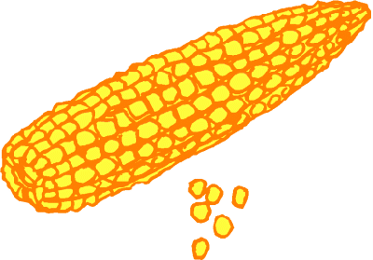
Crop Recommedation
Technology Usage:
Machine Learning
Algorithm: Decision Tree and SVM

Slide 3
Crop
Soil Moisture content
Geographical Location
Previous history
NPK values

Slide 4

Fertilizer Recommendation
Technology Usage:
Deep Learning and Machine Learning
Algorithm:
Naïve Bayes and Neural Networks

Slide 5
NPK values
Crop from previous output
Fertilizer data of plants
Fertilizer

Slide 6
PRICE PREDICTION
Technology:
Deep Learning and Moving average models
Exhaustive
Considering a lot demand vs supply
Festival seasons
Time series forecasting

Slide 7
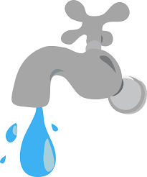
IRRIGATION SYSTEM[REFINED OBJECTIVE]
Technology:
IoT and Mechanical devices
Controlled flow of water using the data from moisture sensor.

Slide 8
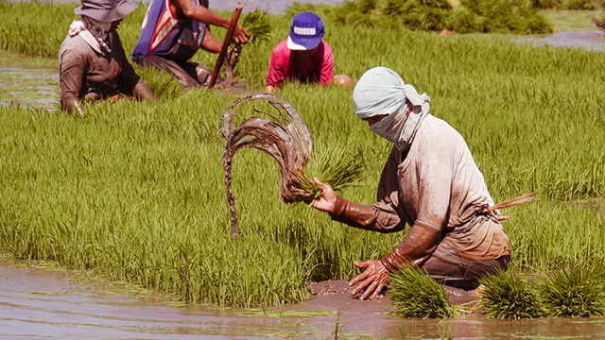
FARMER PEER SUPPORT
Peer to Peer support
FAQ and queries
Dashboard for all data
Interactive graphs and insights

Slide 9
THANK YOU

